Slide 1
CHINO BASIN WATERMASTER
2020 OBMP Update
Listening Session #1
January 15, 2019

Slide 2
Agenda
Introductory Remarks
History of the OBMP and its Implementation
Rationale for an Update of the OBMP
Summary and Next Steps

Slide 3
Why was the OBMP created?
Paragraph 41 of the Judgment provides that “Watermaster, with advice of the Advisory and Pool Committees, is granted discretionary powers in order to develop an optimum basin management program 26 for Chino Basin, including both water quantity and quality considerations.”
Confronted with the then-existing challenges and opportunities facing the Basin, Judge Gunn ordered Watermaster to complete an OBMP by June 30, 2000.

Slide 4
How was the OBMP developed?
Parties convened twice-a-month meetings and several workshops to develop the technical features of the OBMP and the implementation agreement
Elapsed time from Court Order in February 1998 to start of implementation in July 2000 ~ 30 months
Open, transparent, stakeholder process
Stakeholders created a mission statement and core values to guide OBMP development process

Slide 5
Mission Statement: Develop a groundwater management program that enhances the safe yield and the water quality of the Basin, enabling all groundwater users to produce water from the Basin in a cost-effective manner.
Core Values:
Water Quality: Maintain and enhance beneficial uses
Long View: Ensure stable planning and management
Increase Local Supplies
Manage Groundwater Storage: Maximize water quality and reliability; minimize the cost of water supply for all producers
Recharge: Increase recharge of storm and recycled waters to maintain and enhance basin yield and water quality
Cost: Utilize poor-quality groundwater in a cost-effective and efficient manner

Slide 6
Technical features of OBMP were developed by:
Compiling available data and defining the State of the Basin
Soliciting and considering all stakeholder issues, needs and wants
Asking the parties to clearly articulate management goals, the impediments to the goals and the expected result of removing the impediment (Table 3-8 from OBMP report)
Developing specific programs, facility plans and operating schemes to remove the impediments to the goals → nine OBMP Program Elements
Preparing a “time-certain” implementation plan for each Program Element

Slide 7
OBMP Program Elements
Comprehensive Groundwater Monitoring – PE 1
Comprehensive Recharge Program – PE 2
Water Supply Plan for Impaired Areas – PE 3
Subsidence Management Program – PE 4
Regional Supplemental Water Program – PE 5
Cooperative Programs with Regulators – PE 6
Salinity Management Program – PE 7
Storage Management Program – PE 8
Storage and Recovery Program – PE 9

Slide 8
Peace Agreement
The Peace Agreement provided the legal structure to enable binding commitments among the parties to the Judgment.
The Agreement was unanimously supported by the Advisory and Pool Committees, the State of California and the individual members of the Appropriative Pool.
Opened the door to state and federal funding >$100M
Construction of 50 mgd of desalting capacity and the safe storage of 600 AF of water.

Slide 9
OBMP Programmatic EIR (PEIR)
Why the programmatic approach to environmental compliance pursuant to CEQA for the OBMP?
PEIR work began in 1999 and concluded in July 2000
Environmental setting for the OBMP PEIR was substantially different in 2000 compared to today
Recycled-water discharges to Prado Basin were greater
Endangered species issues were much simpler

Slide 10
OBMP PEIR
Only one potentially significant adverse impact identified in the PEIR: operational, cumulative air quality due to energy consumption
Statement of overriding considerations adopted by the IEUA Board in 2000.
The water issues encountered at each stage of OBMP implementation were addressed at those times.

Slide 11
OBMP PEIR
All specific projects implemented between 2000 and 2010 relied on the PEIR and the subsequent Facilities Master Plans PEIR for environmental findings
Subsequent EIRs:
Peace II Project SEIR (2010): Desalter Expansion, Basin Reoperation and Hydraulic Control
IEUA Facilities Master Plan PEIR (2016): Six IEUA Master Plans evaluated
PEIR/SEIRs have been assisted successful grant applications

Slide 12
OBMP Implementation
What did we accomplish in implementing the OBMP?
Costs/Benefits
What did we not accomplish?

Slide 13
Storm and supplemental water recharge
Urbanization and flood control improvements reduced groundwater recharge and net recharge
Existing recharge capacity was insufficient to meet Replenishment and other basin management needs.
Recharge master plans were completed in 2002, 2013 and 2018
Recharge improvements have been completed at 20 existing and new recharge facilities
Additional improvements will be completed by 2021
Cumulative RMP stormwater recharge through 2018 is 137,000 af
Cumulative imported water recharge through 2018 is 196,000 af

Slide 14
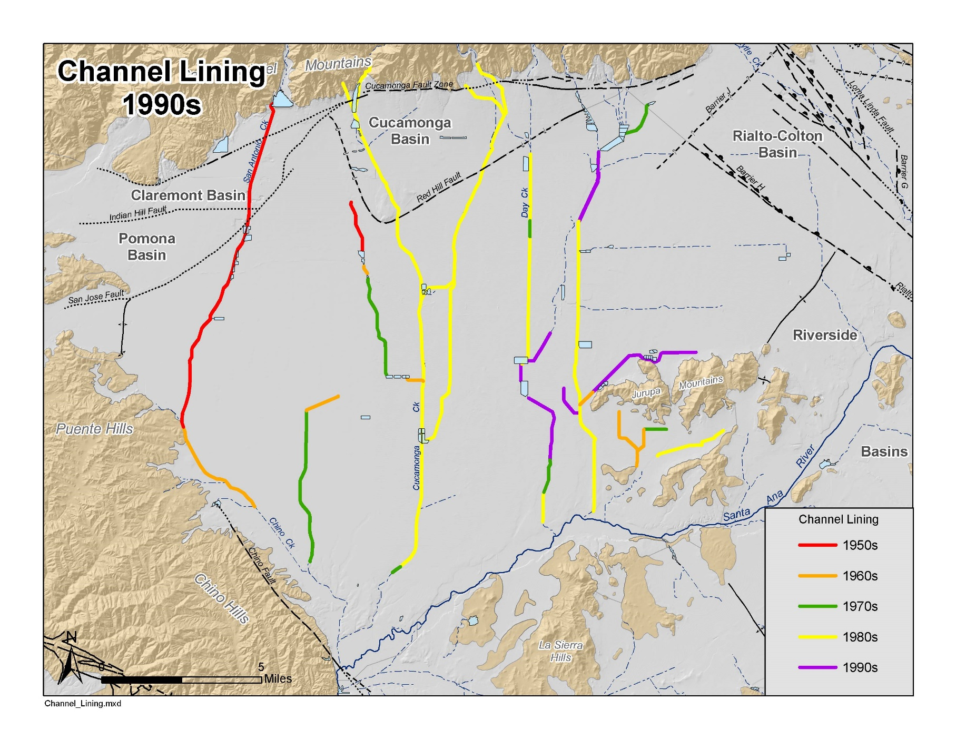
Channel Lining
1950 to 2000
Notes:
The Santa Ana Region has just completed a lengthy but successful process to update its Basin Plan in 2004. This is now a Basin Plan that not only addresses the protection of water quality, but also promotes sound water supply planning.

Slide 15
By 2021, the OBMP recharge projects implemented by Watermaster, IEUA , CBWCD and SBCFCD will have mitigated the stormwater recharge lost through channel lining
Historical Recharge
Average Recharge 2013 RMPU
Average Recharge 2002 RMPU

Slide 17
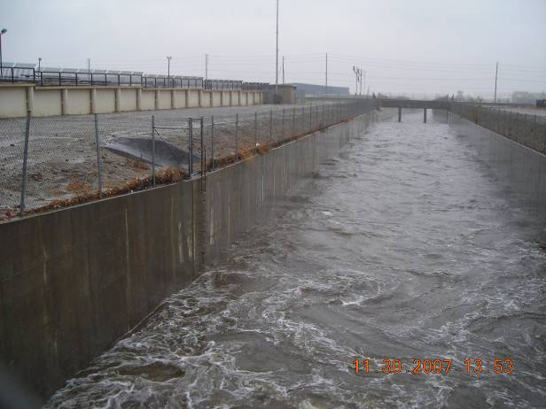
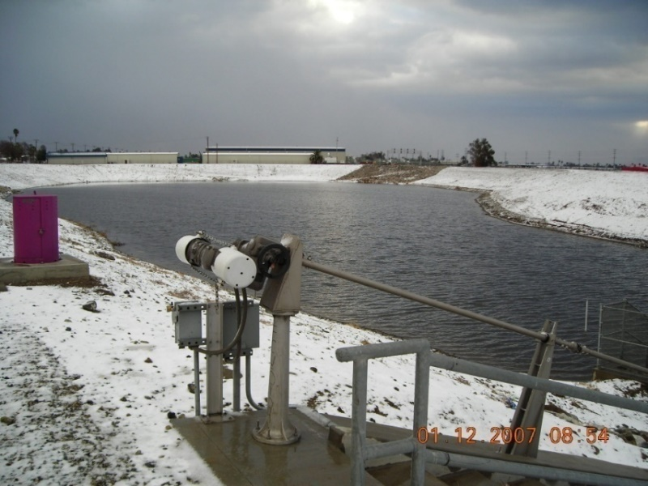
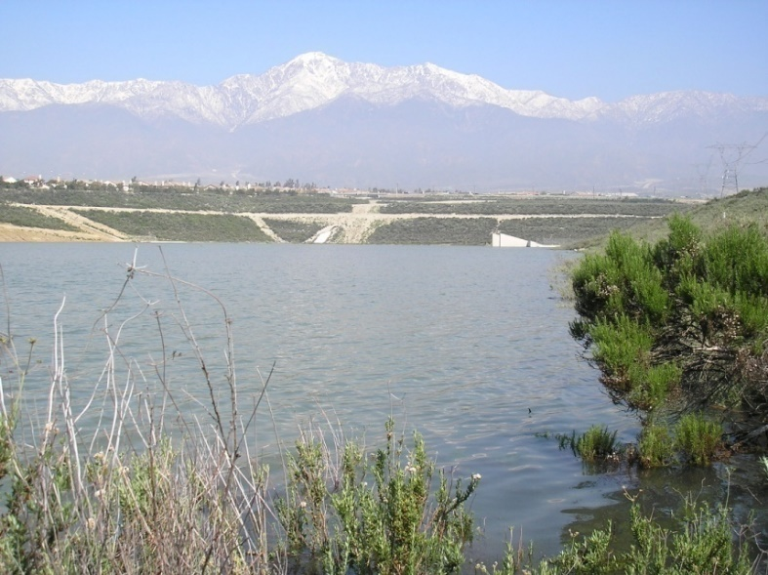
21 Recharge facilities were improved:
Storm water recharge increased by 9,000 afy in 2006 and will increase to 13,800 afy in 2021
Supplemental recharge capacity increased by 26,700 afy
Recycled water recharge increase by 16,000 afy

Slide 18
Land subsidence management
Land subsidence and ground fissuring occurred in the City of Chino in the early 1990s
Subsidence management plans were adopted in 2007; updated in 2015
Subsidence has reduced in the “MZ-1 Managed Area” to what appears to be tolerable rates. Monitoring is ongoing.
The monitoring program has revealed other areas of ongoing land subsidence.
Northwest MZ-1
Northeast Area (central MZ-2)

Slide 19
Land subsidence management
A similar approach to developing subsidence-management strategies is being employed in these areas:
Monitoring and investigations
Modeling to assist development of management strategies
Stakeholder engagement
Management plan for Northwest MZ-1 will be developed in the next few years

Slide 20
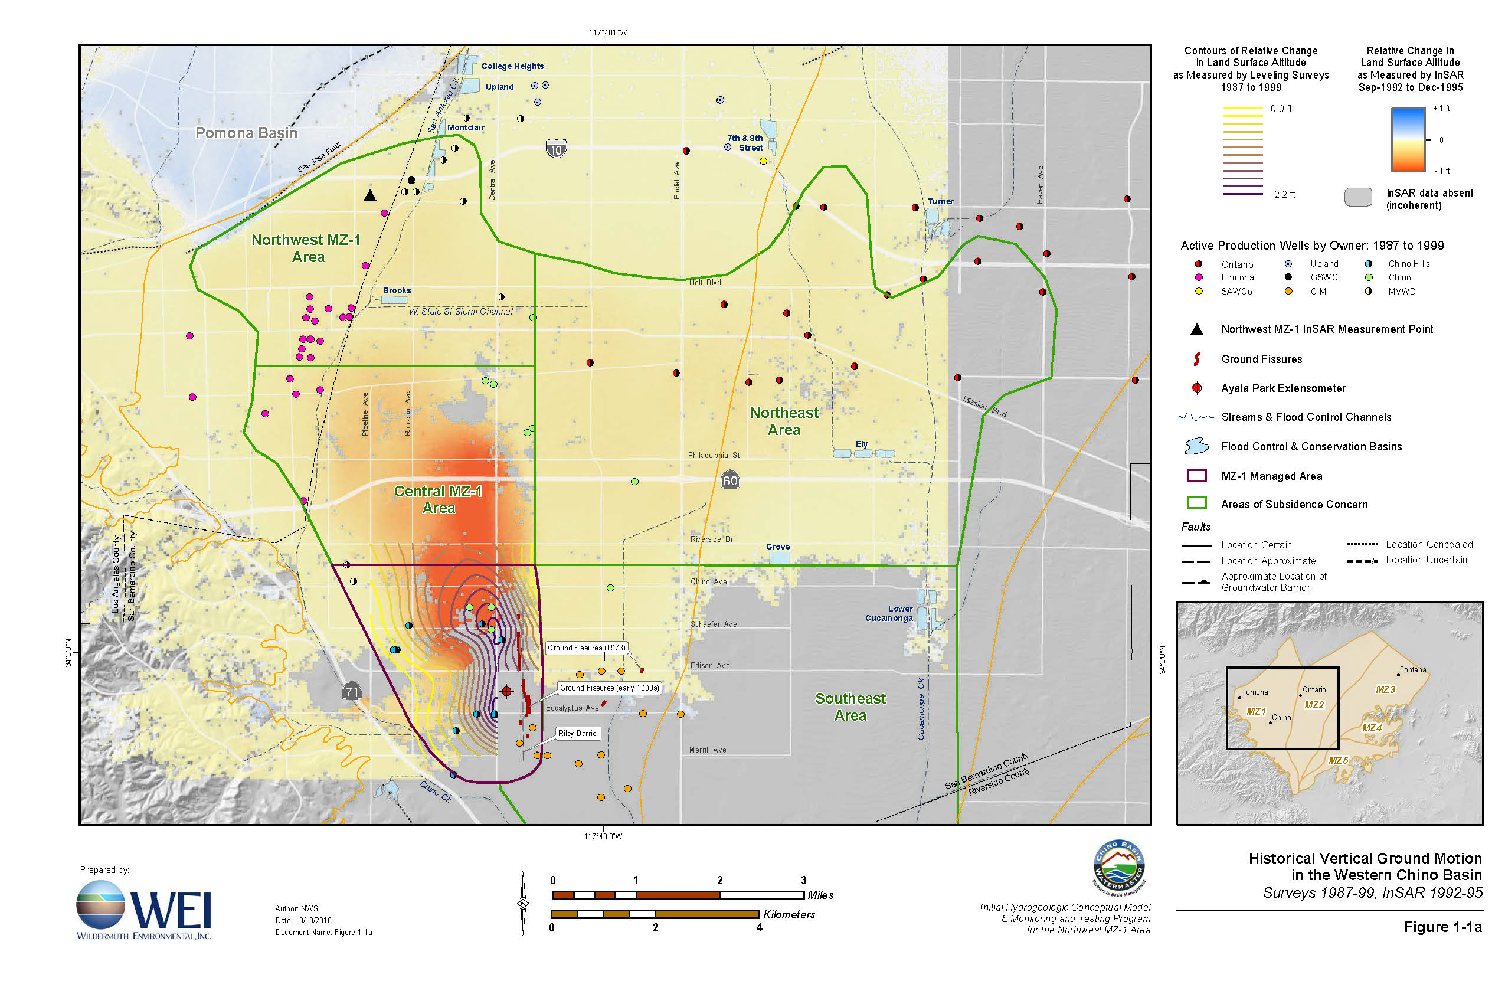
Vertical Ground Motion
1992-1995

Slide 21
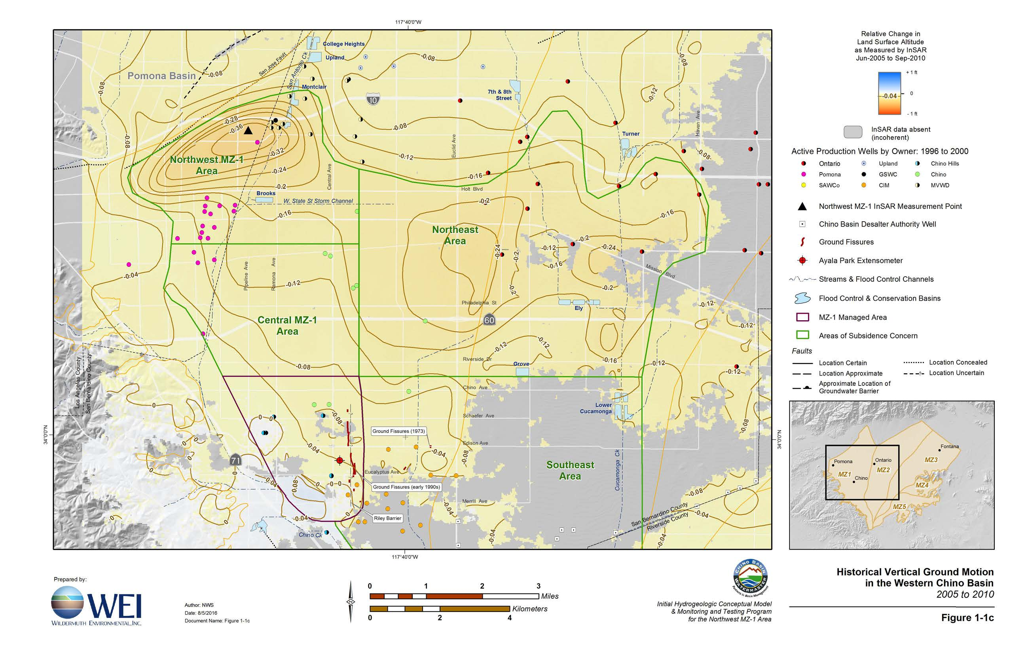
Vertical Ground Motion
2005-2010

Slide 22
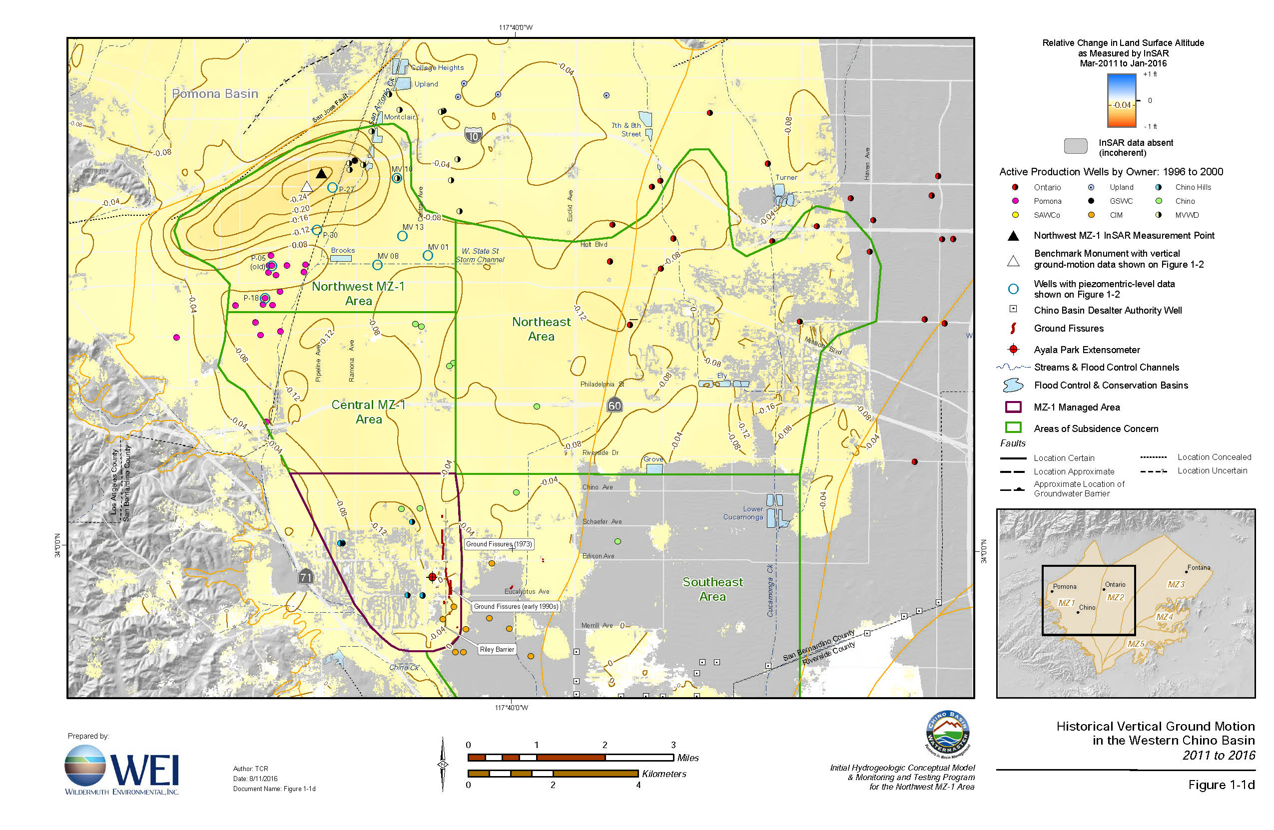
Vertical Ground Motion
2011-2016

Slide 23
Groundwater desalters
The groundwater desalting program was designed to protect and enhance safe yield:
By replacing declining agricultural groundwater pumping in the southern part of the basin with new groundwater pumping
To meet increasing municipal water demands in the same area
The desalter wells were constructed in strategic locations to:
Minimize groundwater outflow to the Santa Ana River
Increase the Santa Ana River recharge into the basin
Minimize future TDS and nitrogen regulatory liabilities in the Chino Basin and the Santa Ana River

Slide 25
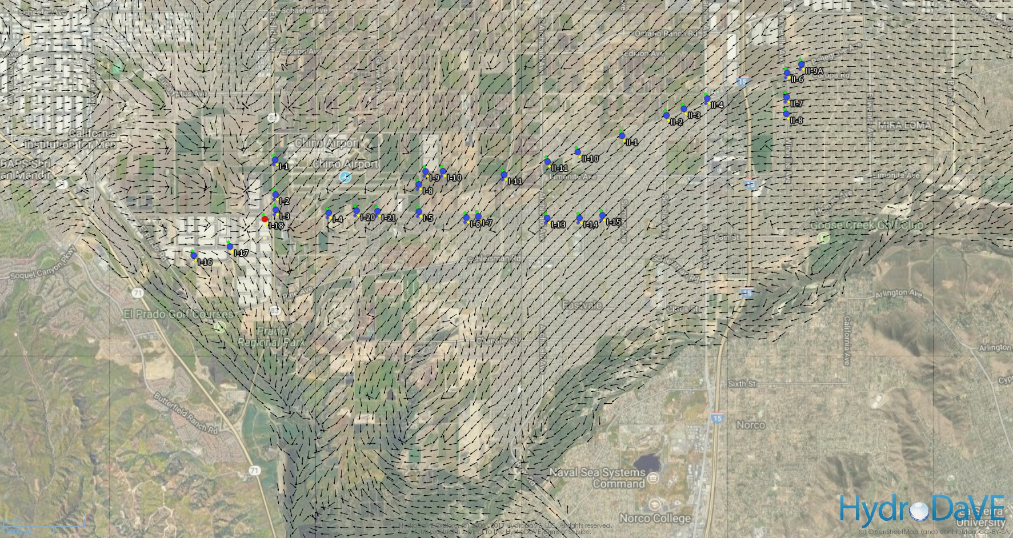
Groundwater Flow Directions
Pre-CDA Pumping (2000)

Slide 26
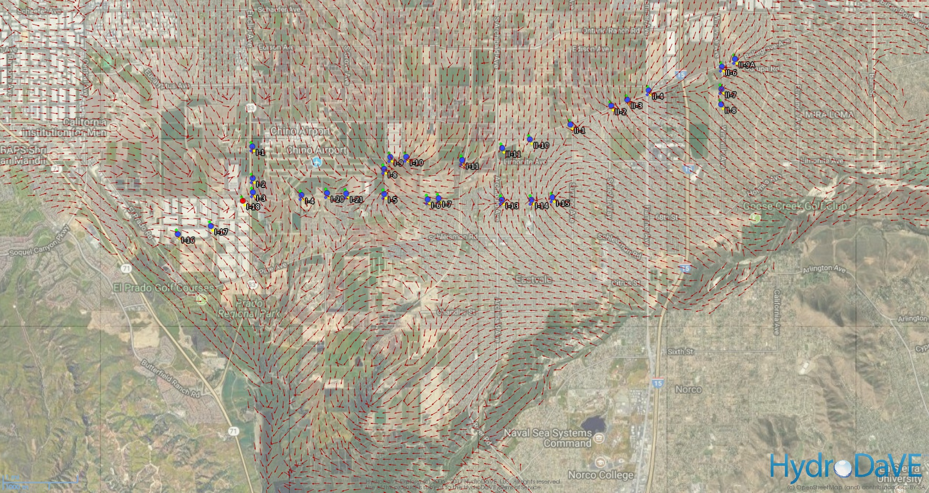
Groundwater Flow Directions
Post-CDA Pumping (2011)

Slide 27
Since 2007, Chino desalter pumping has contributed about 15,000 afy to net recharge
Since 2007, Chino desalter pumping has contributed about 15,000 afy to net recharge

Slide 28
Recycled water
Since 2000, the IEUA has constructed and operated a recycled water conveyance system throughout the basin enabling it to provide recycled water to its member agencies
Recycled water deliveries grew from about 3,400 afy in 2000 to about 34,000 afy in 2017. Cumulatively through FY 2018 = 357,000 af
Recycled water provided by the IEUA has replaced a like amount of groundwater and imported water that would have otherwise been used for non-potable purposes
Recycled water is more reliable than imported water, and thus using it in lieu of imported water has improved the sustainability of the Chino Basin and water-supply reliability

Slide 31
Maximum Benefit update
During the period 1998 through 2002, the Regional Board and watershed stakeholders were completing an update to the salt and nutrient management plan in the Basin Plan
Proposed new groundwater management areas designated as “groundwater management zones”
New antidegradation TDS and nitrate objectives were established based on 1973 conditions
Resulted in a finding of no assimilative capacity for TDS and nitrate in the Chino Basin

Slide 32
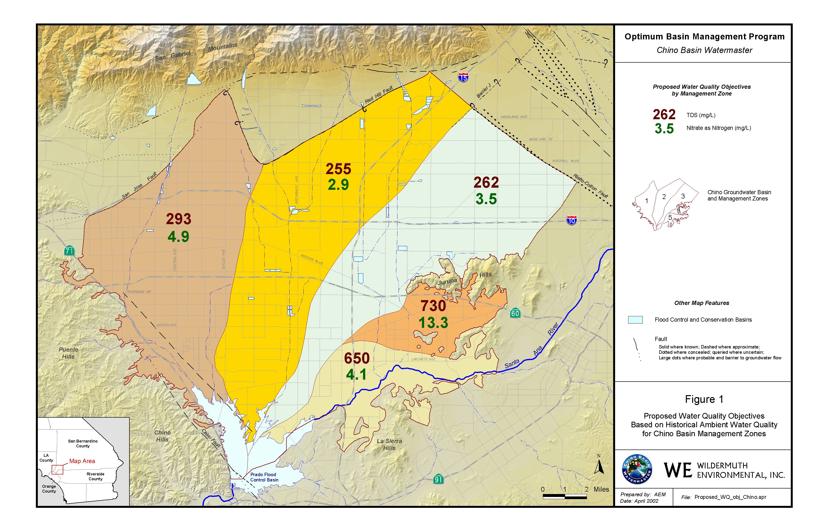

Slide 33
Maximum Benefit update
Under the traditional Regional Board approach, the Regional Board:
Would require mitigation for imported water recharge if TDS of imported water exceeded the objective
Would require mitigation for recycled water reuse
Mitigation of these salt loads would be required on one-for-one basis in each groundwater management zone

Slide 34
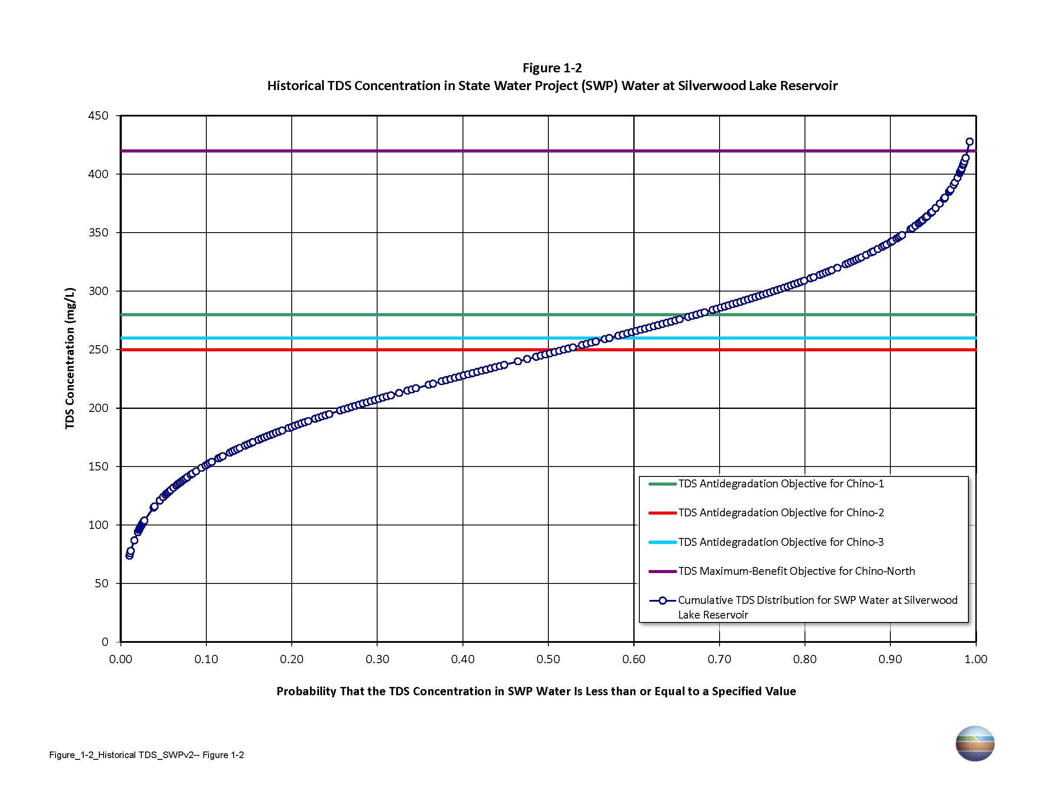
Without maximum benefit-based objectives, mitigation would be required to recharge imported water when its TDS exceed the TDS objective ~ 30 to 50 percent of the time

Slide 36
Maximum Benefit update
Watermaster/IEUA proposed a new water quality paradigm called “maximum benefit” based on SWRCB resolution 68-18 and Water Code 13241
New paradigm required the Chino Basin parties to commit to the recharge and groundwater desalting plans in the OBMP and attainment of hydraulic control

Slide 37
Maximum Benefit update
Resulting Basin Plan changes:
The regulatory groundwater management zone boundaries were changed creating the Chino North GMZ
TDS and nitrate objectives for Chino North GMZ were developed to enable the implementation of the OBMP — particularly the use of recycled and imported water — without TDS and nitrate mitigation for at least 30 years (~2034)
Groundwater TDS trends suggest that TDS mitigation related to ambient TDS concentrations will not be required until at least 2051

Slide 38
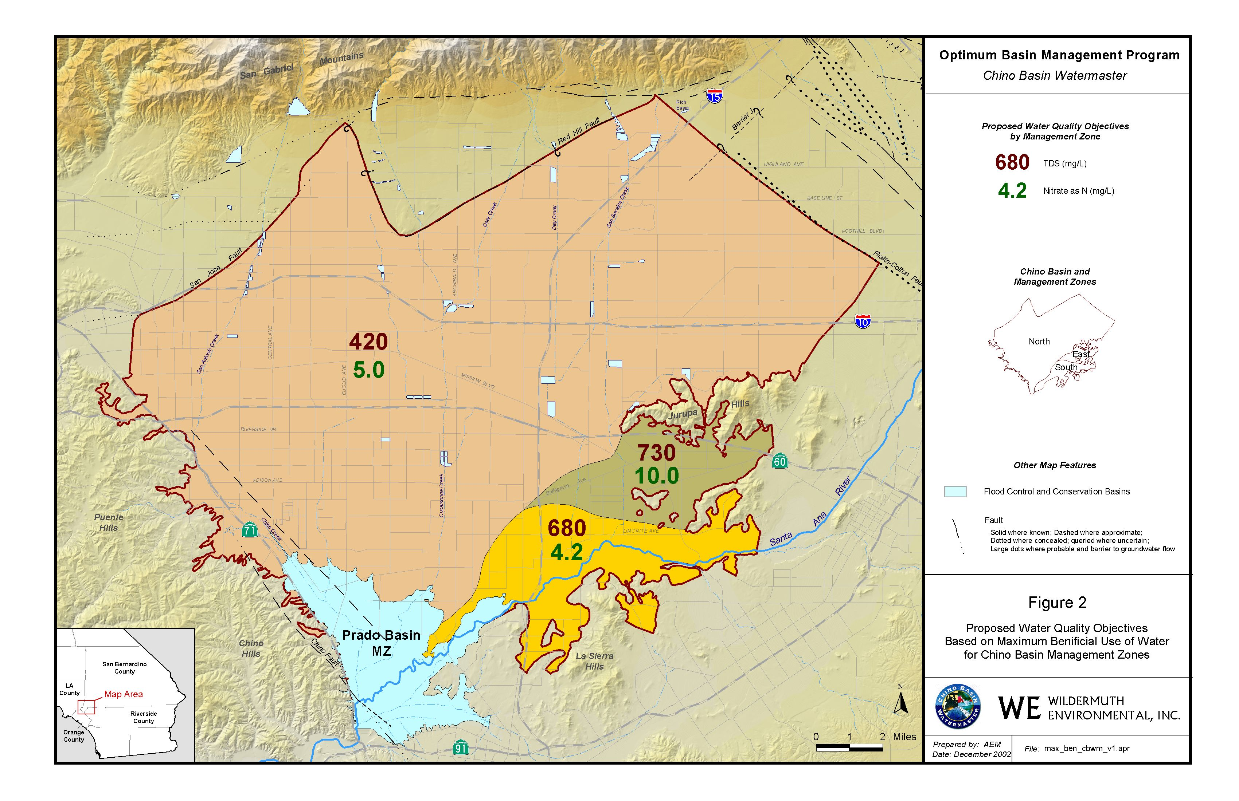

Slide 39
Maximum Benefit update
Because of new maximum benefit-based TDS objectives, the following occurred since 2004 without the cost of TDS removal:
Direct recycled water reuse = 230,000 af
Recharge of recycled water = 109,000 af
Recharge of imported water = 168,000 af
Total 507,000 af

Slide 40
Storage and Recovery
Per the Peace Agreement, the parties were encouraged to develop and implement Storage and Recovery programs that would provide broad mutual benefit to the Judgment Parties and reduce the cost of OBMP implementation
Watermaster, IEUA, TVMWD, WMWD, and Metropolitan implemented a 100,000 af storage program called the Dry-Year Yield Program (DYYP) in 2005. This program runs through 2028.
IEUA is currently working to obtain a $207 million grant to develop and implement a Storage and Recovery program

Slide 41
What was not accomplished
Goal Enhance Basin Water Supplies
Impediment: Unless certain actions are taken, groundwater levels in MZ1 will continue to decline adding to the potential for additional subsidence, and fissures, lost production capability and water quality problems
OBMP action – Manage groundwater production in MZ1 to a sustainable level to minimize subsidence
Efficacy – Implemented in the “Managed Area” but not outside of the Managed Area where active land subsidence is occurring. Needs management plan and infrastructure to implement.

Slide 42
What was not accomplished
Goal Enhance Basin Water Supplies
Impediment: Because future demands are increasing and there are limitations in basin and traditional supplemental water supplies, new sources of supplemental water need to be developed
OBMP action – Development of new supplemental water supplies and regional conveyance
Efficacy – Not implemented

Slide 43
What was not accomplished
Protect and enhance water quality
Impediment: There is ongoing salt and nitrogen loading from dairies
OBMP action – Treat dairy sewage and eliminate discharge to groundwater or export it
Efficacy – Not implemented

Slide 44
What was not accomplished
Protect and enhance water quality
Impediment: Existing production patterns in the basin cause salt and nitrate to accumulate in the southern part of the basin
OBMP action – Increase recharge without an increase in production to cause an increase in rising water
Efficacy – Determined not feasible or desirable and not implemented

Slide 45
What was not accomplished
Equitably finance the OBMP
Impediment: The equitable distribution of cost associated with the OBMP is not defined
OBMP action – Identify ways to recover value from utilizing basin assets including storage and rising water leaving the basin
Efficacy – Need a storage management plan update, infrastructure, and out-of-basin partner(s) to derive broad mutual benefit from storage and recovery programs

Slide 46
Break

Slide 47
Rationale for OBMP Update

Slide 48
Definitions (Exhibit 1)
Drivers
Trends
Implications

Slide 51
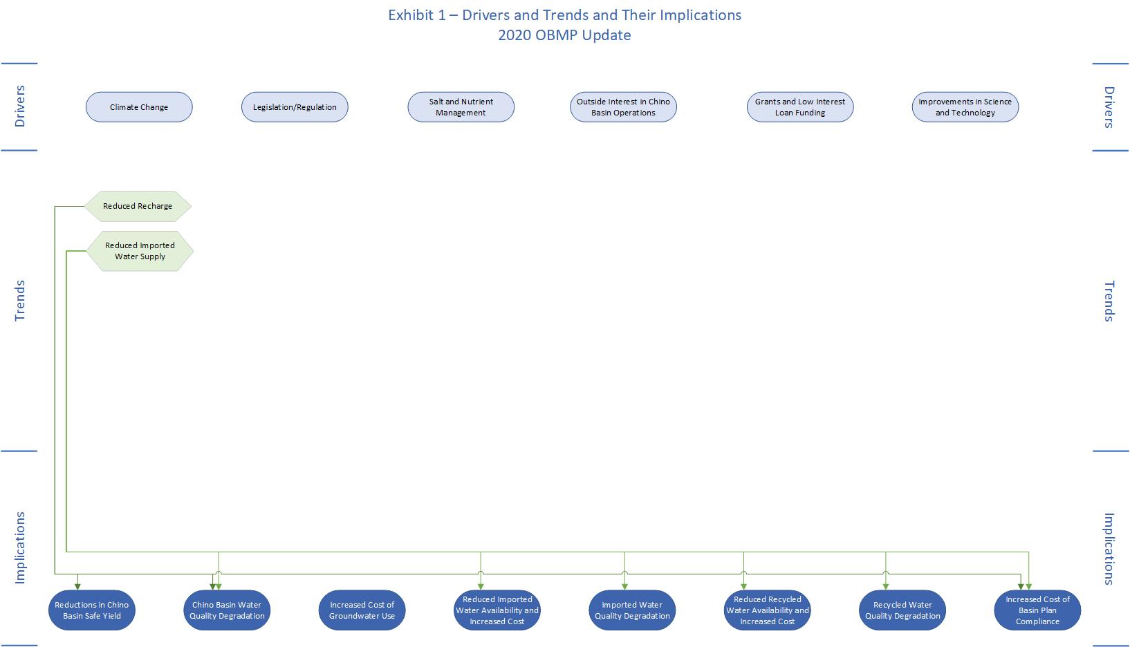

Slide 55
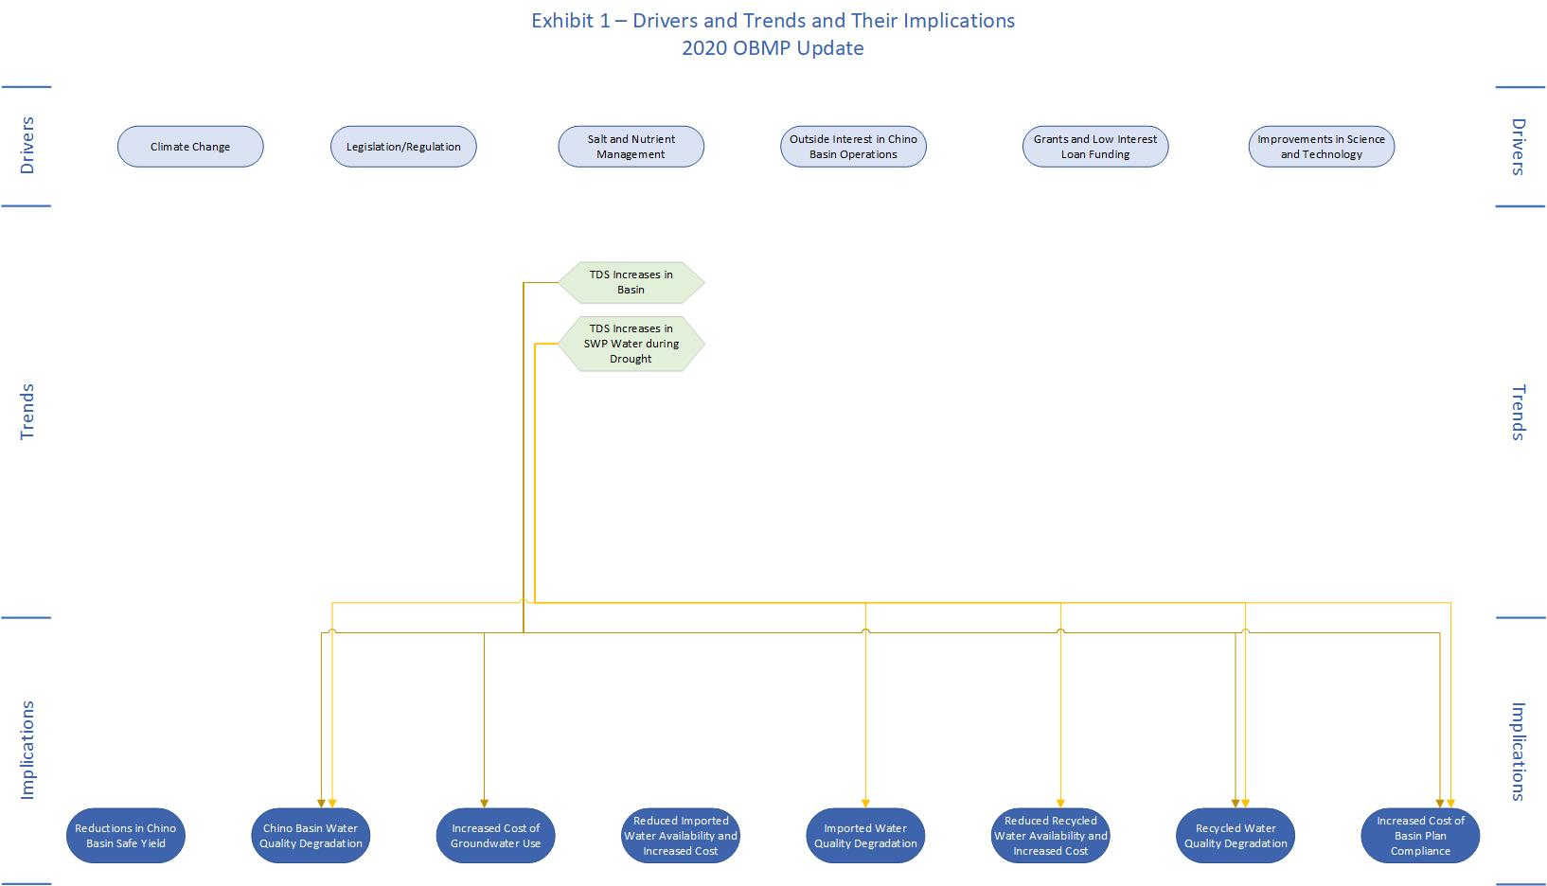

Slide 57
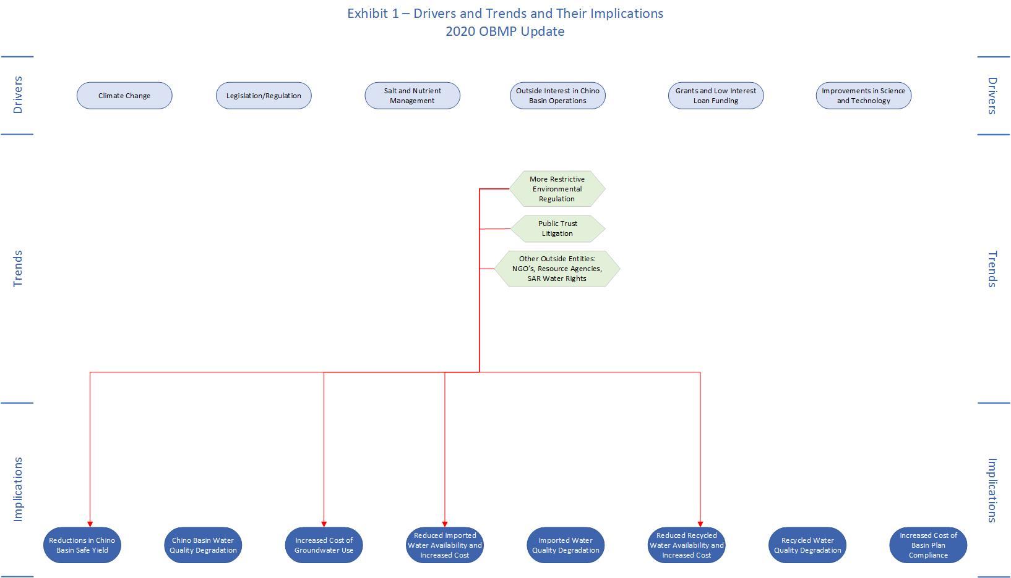

Slide 59
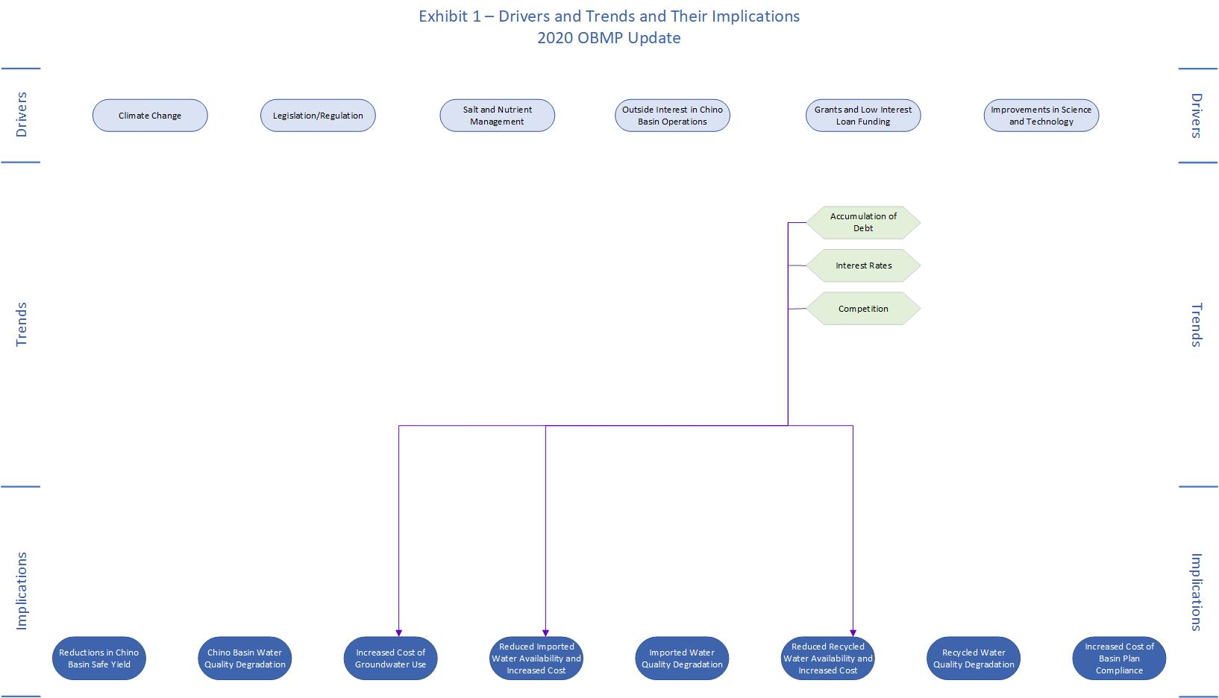

Slide 62
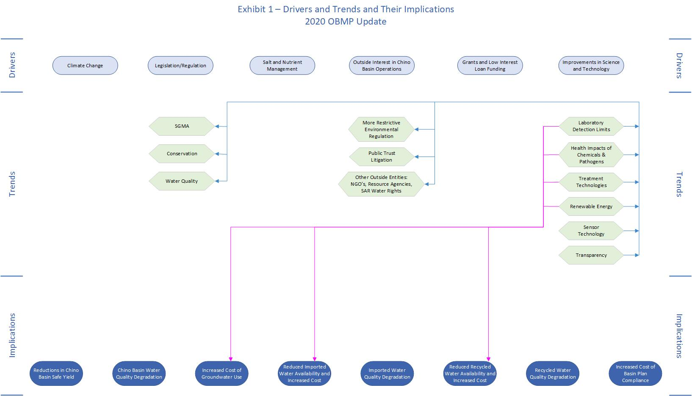

Slide 63
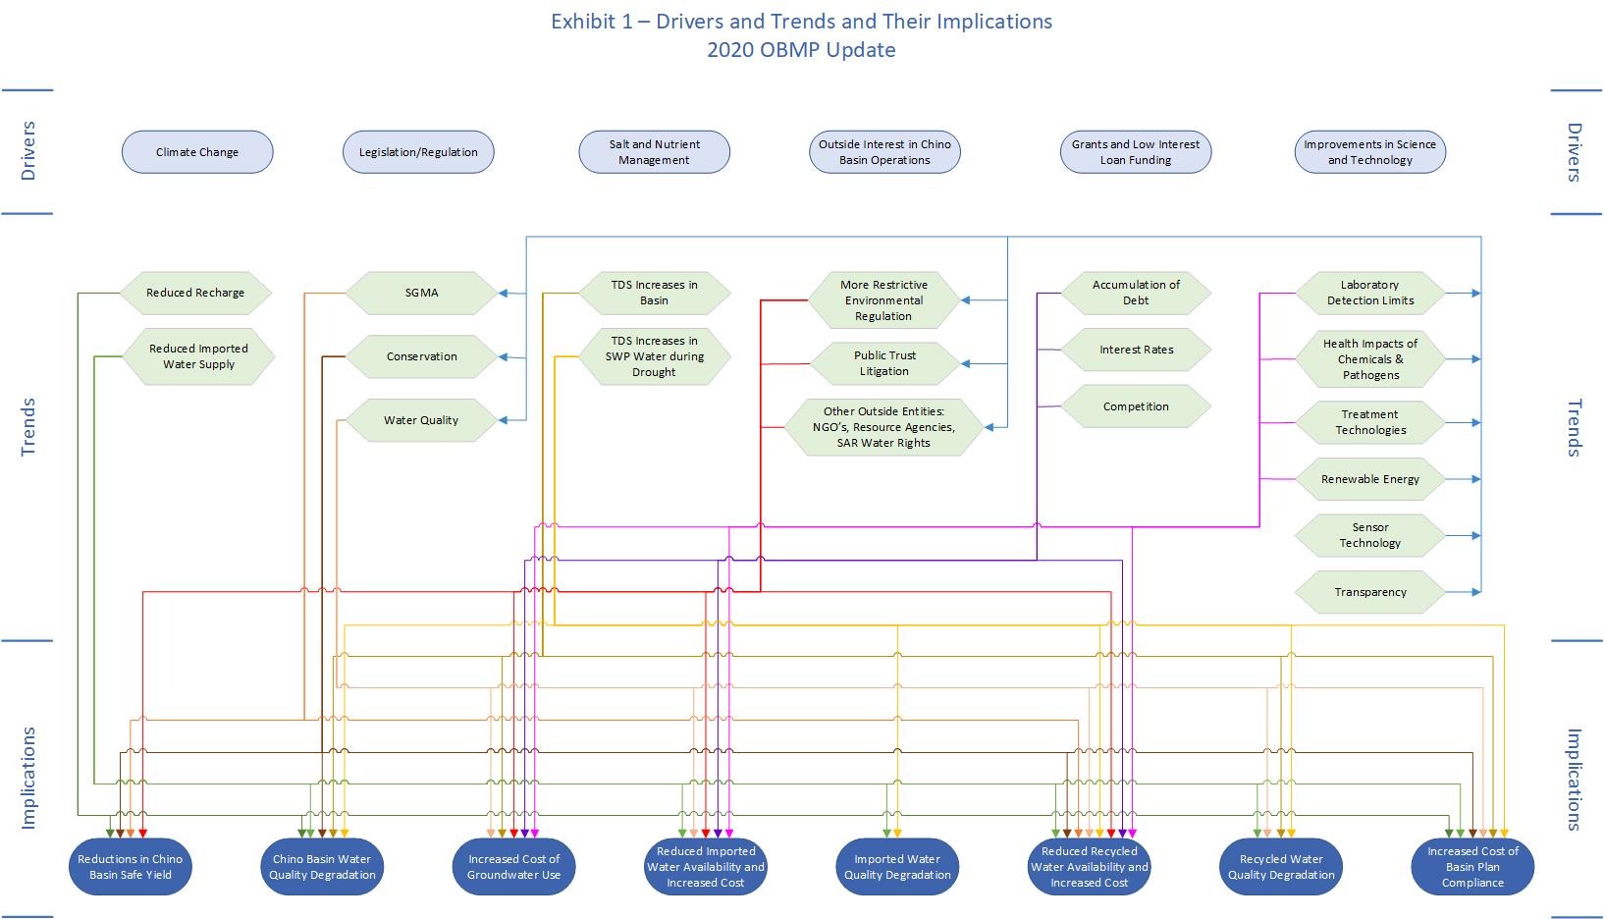

Slide 64
Open Session
Break up into 4 groups for 10 minutes
Discuss and prepare comments and suggested revisions/additions for Drivers, Trends, and Implications
Report back to the larger group

Slide 65
Issues, Needs and Wants
Definitions:
Issue = a Concern
Need = a Requirement
Want = a Desire
Can be related to an individual Party, collective of Parties, or the basin
Will be used to develop OBMP goals, focus problem identification, and develop the scope of the OBMP

Slide 66
Issues, Needs and Wants
Water-supply reliability
Regulations
Groundwater levels
Supplemental waters
Conjunctive use
Equity
Administration
Other
Classes:
Safe yield
Recharge
Water quality
Infrastructure
Storage
Costs
Governance

Slide 67
Example #1:
Issue: Threat of declining Safe Yield
Need/Want: Maintain or enhance Safe Yield
OBMP Goal: Enhance basin water supplies
Impediments to Goal:
Increasing groundwater outflow to the SAR due to declining ag pumping
Decreasing stormwater recharge from urbanization and channel lining
Actions to remove impediments:
Chino Basin Desalters
Recharge Master Plan development and implementation

Slide 68
Example #2:
Issue: Rialto pipeline shutdown
Need/Want: Meet all demands with local water supplies
OBMP Goal: Enhance water-supply reliability
Impediments to Goal:
Groundwater pumping is constrained by capacity, poor quality and subsidence
Intra-basin conveyance is insufficient to utilize groundwater in storage
Actions to remove impediments:
Develop a Storage Management Plan (SMP)
Build pumping, conveyance and treatment facilities to implement the SMP

Slide 69
Open Session
Discussion
Issues
Needs
Wants

Slide 70
Summary and Next Steps
Recap of meeting
Next steps:
Staff will compile meeting notes and emailed input from the Parties into a Listening Session #1 Memorandum
Parties will review Memorandum and provide comments and suggested edits to the DTI chart and the INW matrix
Listening Session #2 (2/13/2019, tentative):
Finalize DTI chart and INW matrix
Begin defining OBMP Update goals and impediments

Slide 71
380 days
Task 1 Project Management and Meetings
342 days
Sep 2018 - Feb 2020
Task 2 Develop OBMP Goals, Impediments, and Actions to Remove Impediments
Nov 2018 - Jul 2019
50 days
Prepare TM 1
Mar - Jul
173 days
Task 3 Develop OBMP Implementation Plan
Jul 2019 - Jan 2020
83 days
Prepare TM 2
Sep 2019 - Jan 2020
LS 4 – review draft TM 1
May 2019
LS 2
LS 5
LS 7 – review draft TM 2
Feb 2019
Jun 2019
Nov 2019
LS 1
LS 3
LS 6
LS 8
Jan 2019
Mar 2019
Jun 2019
Jan 2020
Sep
Nov
Jan
Mar
May
Jul
Sep
Nov
Jan
Today
2018
2019
2020

Slide 72
Schedule of Major Watermaster Initiatives
2018-2020
2018 RMPU
7/2017 - 10/2018
Storage Framework
196 days
7/2017 - 10/2018
196 days
Salt and Nutrient Management Plan Update
500 days
7/2017 - 12/2019
State of the Basin Report
218 days
7/2018 - 5/2019
370 days
Safe Yield Recalculation
7/2018 - 12/2019
239 days
OBMP Update
263 days
1/2019 - 1/2020
OBMP CEQA and Agreements
2018
1/2020 - 7/2020
2018
2019
2020
Jan
Apr
Jul
Oct
Jan
Apr
Jul
Oct
Jan
Apr
Jul
Today

